Slide 1

Service Fabric A Platform for Building and Managing Highly Scalable Services
Shawn Weisfeld
shawn@shawnweisfeld.com
http://www.shawnweisfeld.com

Slide 2


Welcome to Houston TechFest
Thank you for being a part of the 9th Annual Houston TechFest!
Please turn off all electronic devices or set them to vibrate.
If you must take a phone call, please do so in the lobby so as not to disturb others.
Thanks to our Diamond Sponsors:

Slide 3







About Me
Founder of UserGroup.tv
Technical Evangelist at Microsoft
MCSD: Azure Solutions Architect

Slide 4


Watch User Group presentations for FREE online!
All the topics you care about
Including:
Agile
Azure
C#
Entity Framework
HTML5
MVC
Silverlight
XAML
jQuery
and Much More!
Miss a User Group meeting?
Forget something that you learned?
Want to see content from a User Group not in your area?
Want to share with a buddy?
We know you cannot make it to every User Group meeting,
that is why we post them online for you!
We now have over 450 presentations online
New Content added all the time!
Presentations from the thought leaders on the topic.
For new content announcements
@UserGroupTV
http://www.UserGroup.tv

Slide 5
Agenda
Azure Service Fabric platform
Applications and microservices
Programming models
Scaling
Management

Slide 6
Service Fabric at //build
2-700: Building Resilient, Scalable Services with Microsoft Azure Service Fabric
Mark Fussell - Principal Program Manager
Vipul Modi - Principal Software Engineering Manager
2-640: Microsoft Azure Service Fabric Architecture
Gopal Kakivaya - Corporate Vice President
2-717: Deploying and Managing Services with Service Fabric
Chacko Daniel - Principal Program Manager
2-66: Deep Dive into Microsoft Azure Service Fabric Reliable Actors
Claudio Caldato - Principal Program Manager

Slide 7
Cloud Service Architectures
Features
traditional
Scalability
Microservices
User Interface
Availability
User Interface
Business Logic
Data
Latency
Business Logic
Lifecycle
Data Integrity
Data
Portability
Manage Services
Deliver Features Faster
Create Business Value

Slide 8
Battle-hardened for over 5 years
Skype for Business
Hybrid Ops
Azure Document DB
billions transactions/week
Intune
800k devices
Azure Core Infrastructure
thousands of machines
Event Hubs
20bn events/day
Bing Cortana
500m evals/sec
Azure SQL Database
1.4 million databases
Power BI

Slide 9
Microsoft Azure Service Fabric A platform for reliable, hyperscale, microservice-based applications
Microservices
High Availability
Hybrid Operations
Data Partitioning
Service Fabric
Health Monitoring
Container Orchestration & lifecycle management
Self-healing
Simple programming models
High Density
Rolling Upgrades
Low Latency
Placement Constraints
Fast startup & shutdown
Replication & Failover
Hyper-Scale
Automated Rollback
Stateful services
Load balancing
Windows
Server
Linux
Windows
Server
Linux
Azure
Hosted Clouds
Windows
Server
Linux
Private Clouds

Slide 10

Service Fabric cluster with microservices
App1
App2

Slide 11
Handling machine failures
App1
App2

Slide 12
What is a microservice?
Is (logic + state) that is independently versioned, deployed, and scaled
Has a unique name that can be resolved
e.g. fabric:/myapplication/myservice
Interacts with other microservices over well defined interfaces and protocols like REST
Remains always logically consistent in the presence of failures
Hosted inside a “container” (code + config)
Can be written in any language and framework
node.js, Java VMs, any EXE
Developed by a small engineering team

Slide 13
Types of microservices
Stateless microservice
Has either no state or it can be retrieved from an external store
There can be N instances
e.g. web frontends, protocol gateways, Azure Cloud Services etc.
Stateful microservice
Maintain hard, authoritative state
N consistent copies achieved through replication and local persistence
e.g. database, documents, workflow, user profile, shopping cart etc.

Slide 14


What can you build with Service Fabric?
Stateless applications
A service that has state where the state is persisted to external storage, such as Azure databases or Azure storage
e.g. Existing web (ASP.NET) and worker role applications
Stateful applications
Reliability of state through replication and local persistence
Reduces latency
Reduces the complexity and number of components in traditional three tier architecture
Existing apps written with other frameworks
node.js, Java VMs, any EXE

Slide 15
Service Fabric Applications
Applications composed of microservices
Reliable Actors API
Reliable Services API
High Availability
Data Partitioning
Service Fabric
Health Monitoring
Container Orchestration & lifecycle management
Hybrid Operations
Self-healing
Simple programming models
High Density
Rolling Upgrades
Low Latency
Placement Constraints
Fast startup & shutdown
Replication & Failover
Hyper-Scale
Automated Rollback
Stateful services
Load balancing
Azure
Private Clouds

Slide 16
Reliable Actors

Slide 17
Reliable Actor API
Build reliable stateless and stateful objects with a virtual Actor Programming Model
Suitable for applications with multiple independent units of state and compute
Automatic state management and turn based concurrency (single threaded execution)

Slide 18
With Reliable Actors:
It easier to think about services as composed of smaller/independent/inter-connected entities.
Easy to get started
Familiar design patterns
Code & State are reliable
It is designed to scale

Slide 19
Reliable Actors other features
Actors are ‘just’ objects
Pass them around
Exceptions are automatically propagated
GC:
The framework periodically scans for actors that have not been used for some period of time, and deactivates them. Once deactivated GC collects them.
GC frequency & Idle timeout can be customized at assembly and Actor type level
Timers & Reminders:
Useful to trigger recurring tasks on Actors
Reminders are not lost upon failures
Events:
Simple Pub/Sub model that Actors can use to send ‘messages’ to a client application/Web Frontend

Slide 20
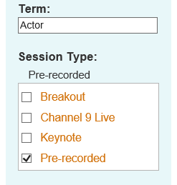
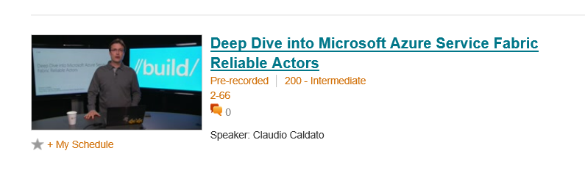
Learn more about Reliable Actors APIs
Watch pre-recorded session
http://channel9.msdn.com/Events/Build/2015/2-66

Slide 21
Reliable Services

Slide 22
Reliable Services API
Build stateless services using existing technologies such as ASP.NET
Build stateful services using reliable collections
Manage the concurrency and granularity of state changes using transactions
Communicate with services using the technology of your choice (e.g WebAPI, WCF)

Slide 23
Reliable Collections
Reliable collections make it easy to build stateful services.
Evolution of the .NET collections for the cloud
Collections
Single machine
Single threaded
Concurrent
Collections
Single machine
Multi threaded
Reliable Collections
Multi machine
Replicated (HA)
Persistence (durable)
Asynchronous
Transactional

Slide 24


Reliable Collections
IReliableDictionary<K,V>
IReliableQueue<T>
Atomically update one or more collections using transactions
Changes are replicated and durably stored on multiple replicas
Reads are repeatable within the transaction
Enumerations are snapshot based

Slide 25
Making the Move

Slide 26






3-Tier service pattern
Load Balancer
Scale with partitioned storage
Increase reliability with queues
Reduce read latency with caches
Manage your own transactions for state consistency
Many moving parts each managed differently
Front End
(Stateless
Web)
Stateless
Middle-tier
Compute
Cache
Queues Storage

Slide 27

Stateful services: Simplify design, reduce latency
Application state lives in the compute tier
Low Latency reads and writes
Partitions are first class for scale-out
Built in transactions
Fewer moving parts
Load Balancer
Front End
(Stateless
Web)
Stateful
Middle-tier
Compute
data stores used for analytics and disaster recovery

Slide 28




Cloud Service vs Stateful Service Fabric
Cloud Services
Service Fabric
(Stateful)
Reliable Azure Queue
Azure Tables/NoSQL

Slide 29
Replication
Reads are completed at the primary
Writes are replicated to the write quorum of secondaries
Ack
Read
Value
Write
Ack
P
Ack
Ack
Ack
S
S
Write
Write
S
S
Write
Write

Slide 30
Reconfiguration
Types of reconfiguration
Primary failover
Removing a failed secondary
Adding recovered replica
Building a new secondary
Replica States
None
Idle Secondary
Active Secondary
Primary
X
Failed
P
S
P
B
S
S
X
Failed
S
S
Must be safe in the presence of cascading failures

Slide 31
Service partitioning
Services can be partitioned for scale-out
You can choose your own partitioning scheme
Service partitions are stripped across machine in the cluster
Node 100
Node 101
Node 102
Node 103
Node 104
Node 105
P1
P2
P3
S
S
S
S
S
S
P4
S
S
S
P
S
S

Slide 32




Scale-out and partitioning
Load Balancer

Slide 33
Application Lifecycle Management
Provisioning and deployment of constituent microservices
Upgrade microservices without loss of availability
Monitor microservices
Interface with machine management layer for autoscale and initiating reboot, reimage, and repair actions
Provide operational insight into aggregate utilization – inventory, performance counters/metrics, etc. – for capacity planning

Slide 34
Azure Service Fabric
Rapidly develop microservice based applications
Operate reliable, scalable services
Enjoy the confidence of a battle-tested platform
Stateless or Stateful
Visual Studio tools
Focus on features not infrastructure
Rolling upgrades
Testability
Automatic Orchestration
Self-Healing
Comprehensive ALM
Health Monitoring
Diagnostics
The same technology Microsoft uses
Proven more than 5 years
Investment & Roadmap

Slide 35
Call to Action
Download the Service Fabric developer SDK
http://aka.ms/ServiceFabric
Learn from the tutorials and videos
http://aka.ms/ServiceFabricdocs
Provide feedback
http://aka.ms/ServiceFabricforum
http://stackoverflow.com/questions/tagged/azure-service-fabric

Slide 36
Thank you! Your Feedback is Important
Rate My Talk & Download Slides!
http://bit.ly/RateShawnsTalk
Contact Information
Email: shawn@shawnweisfeld.com
Blog: http://www.shawnweisfeld.com
Twitter: @shawnweisfeld

Slide 37
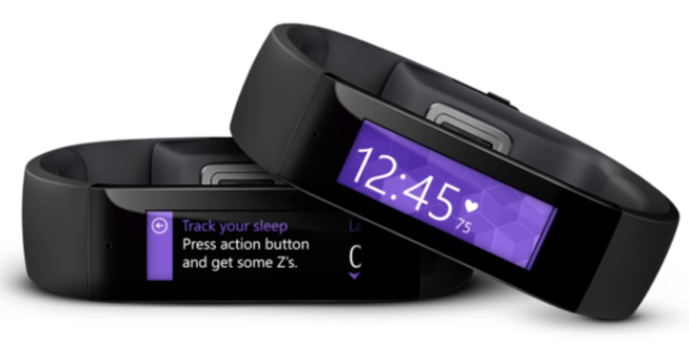
Complete the survey and be entered in the raffle for a chance to win a Microsoft Band.
http://aka.ms/houstontech

Slide 38












Thanks to all our Sponsors!

Slide 39
MICROSOFT SESSIONS
ROOM | TIME | SESSION TITLE | SPEAKER
304 | 9:30 am - 10:30 am | A Taste of Application Deployment as a Service, in a DYI Fashion with Azure PowerShell | Yung Chou
301 | 10:40 am - 11:40 am | Intro Windows 10 Development | Paul DeCarlo
301 | 11:50 am - 12:50 pm | LUNCH SESSION
313 | 1:00 pm - 2:00 pm | T-SQL New Features for Developers | John Cook
300 | 2:10 pm - 3:10 pm | Staying Afloat in the .NET Asynchronous Ocean | Mike Huguet
404 | 2:10 pm - 3:10 pm | Service Fabric: A platform for Building and Managing Highly Scalable Services | Shawn Weisfeld
Main Hall | 3:20 pm - 4:00 pm | SPONSOR GIVEAWAY
301 | 4:10 pm - 5:10 pm | Introduction to "The Internet of Things" | Paul DeCarlo
300 | 5:20 pm - 6:20 pm | Keeping Code Clean with Visual Studio 2015 Live Code Analyzers | Mike Huguet
310 | 5:20 pm - 6:20 pm | Building Business Apps with Azure Mobile Apps | Brian Sherwin
313 | 5:20 pm - 6:20 pm | Always On for Developers | John Cook
300 | 6:30 pm - 7:00 pm | CLOSING REMARKS AND DOOR PRIZES

Slide 40

Please Leave Feedback During Q&A
If you leave session feedback and provide contact information in the survey, you will be qualified for a prize
Scan the QR Code to the right or go to http://bit.ly/1K1Hvi5

Slide 41

© 2015 Microsoft Corporation. All rights reserved. Microsoft, Windows, Windows Vista and other product names are or may be registered trademarks and/or trademarks in the U.S. and/or other countries.
The information herein is for informational purposes only and represents the current view of Microsoft Corporation as of the date of this presentation. Because Microsoft must respond to changing market conditions, it should not be interpreted to be a commitment on the part of Microsoft, and Microsoft cannot guarantee the accuracy of any information provided after the date of this presentation. MICROSOFT MAKES NO WARRANTIES, EXPRESS, IMPLIED OR STATUTORY, AS TO THE INFORMATION IN THIS PRESENTATION.

